Slide 1

Streamlining Software quality with DevOps Automation
Guruteja Kanderi
Chandini Nalamalapu
Ritesh Bag

Slide 2
INTRODUCTION:
In Today’s Dynamic software landscape, where rapid innovation and customer satisfaction reign supreme, traditional manual testing methods often fall short in ensuring high-quality software delivery. These time-consuming and error-prone approaches can lead to delays, undetected bugs, and a compromised user experience. To overcome these challenges, DevOps Automation emerges as a game-changer, streamlining the software quality assurance process and propelling businesses towards success.

Slide 3
Leveraging Jenkins and SonarQube:
Jenkins, a continuous integration (CI) tool, automates the testing process, triggering tests as code is pushed to GitHub.
SonarQube, a code quality management tool, analyzes code for bugs and defects.
Code → SonarQube Scanner → Analysis → Issue Detection → Issue Reporting → Developer Review → Code Improvement

Slide 4
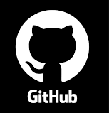



Objectives and Vision:
Streamlining software development through end-to-end DevOps automation, integrating tools, provisioning infrastructure, and fostering a culture of continuous improvement for efficient and quality-driven deployment.
Automate → Integrate Tools → Provision Infrastructure → Build CI/CD Pipelines → Achieve Code quality

Slide 5
Project Flow
Create new project in SonarQube
Generate the new build using Maven in Jenkins to run code
Push code in GitHub
Analyze the results

Slide 6
Content:
Provision AWS instances for Jenkins, Maven and SonarQube.
Install JDK, Jenkins, Maven and SonarQube with respect to their server's.
Provision GitHub repository with pom.xml and newly developed code for the application that is testing for deployment.
Create a SonarQube project and generate a secret text for communicating with Jenkins server.
Configure Jenkins with JDK, Maven ,GIT and SonarQube requirements.
Initiate the Jenkins Pipeline to create the build and begin the testing for deployed code through GitHub via SonarQube.
After successful build , you will have the test results, bugs and other data to analyze.

Slide 7
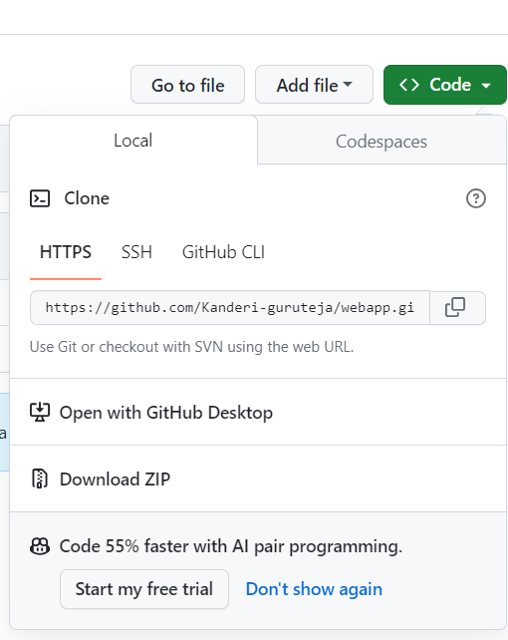
GitHub Repository Setup
Provision GitHub repository with:
pom.xml file
Newly developed code for the application to be tested
for deployment.

Slide 8
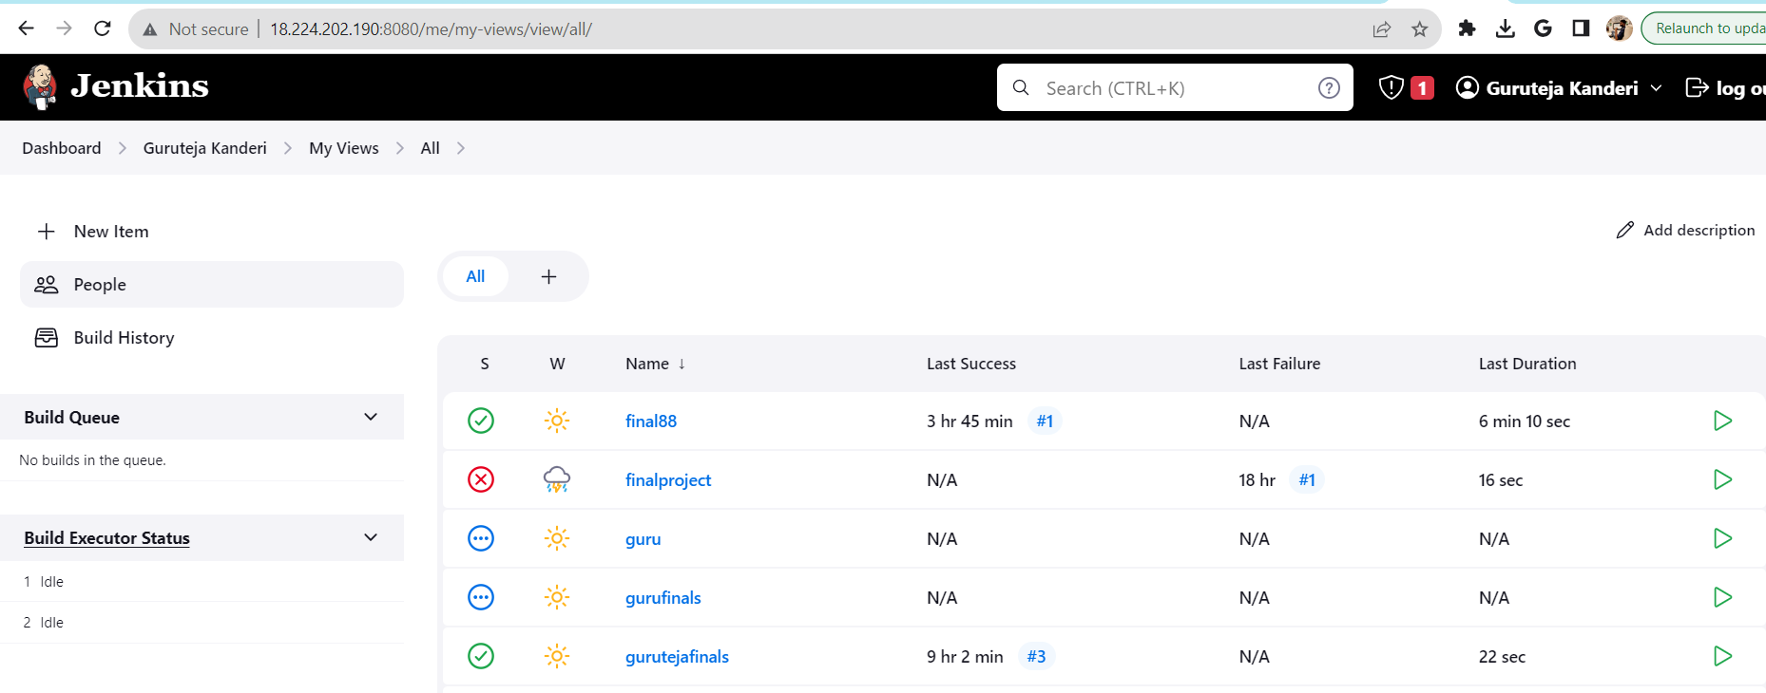
Jenkins Configuration Configure Jenkins with: JDK Maven Git SonarQube requirements

Slide 9
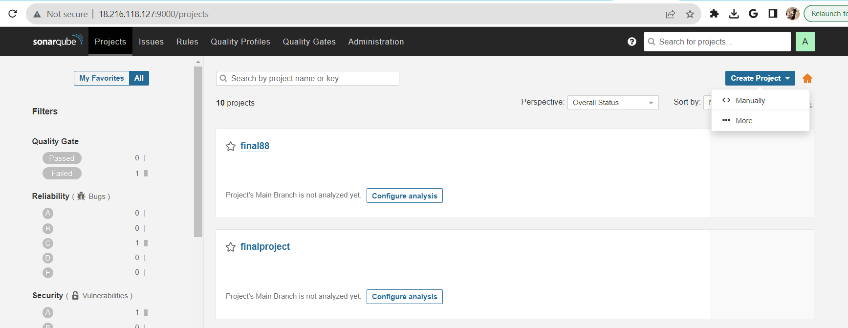
SonarQube Project Setup
Create a SonarQube project.
Generate a secret text for secure communication with the Jenkins server.

Slide 10
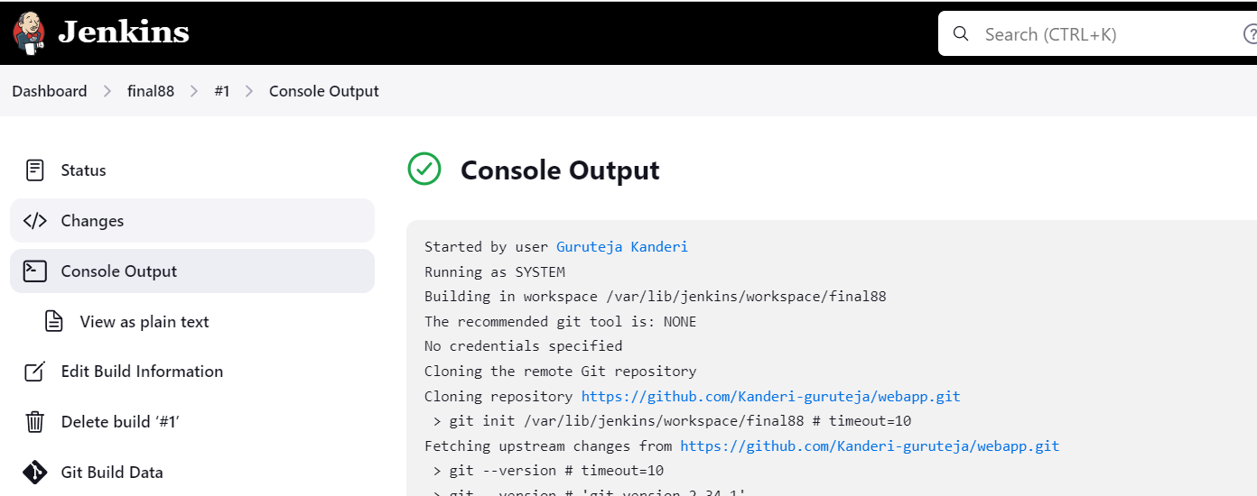
Jenkins Pipeline Setup
Initiate the Jenkins Pipeline
Create the build using maven
Begin testing for the deployed code via GitHub and SonarQube integration.

Slide 11
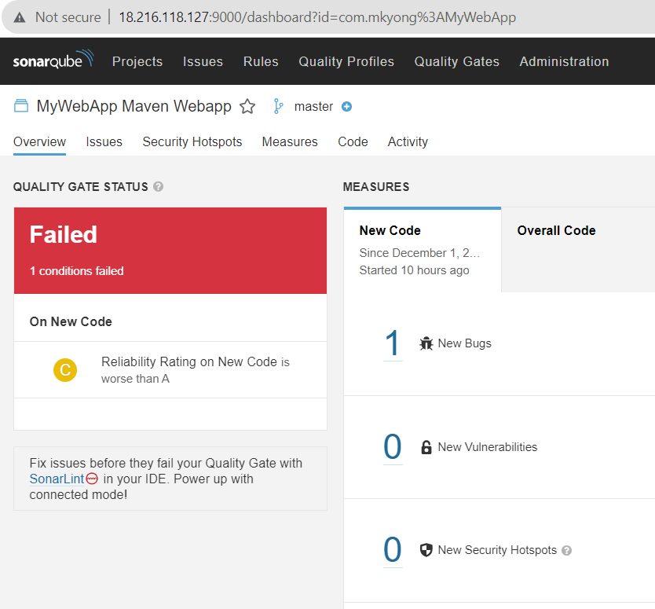
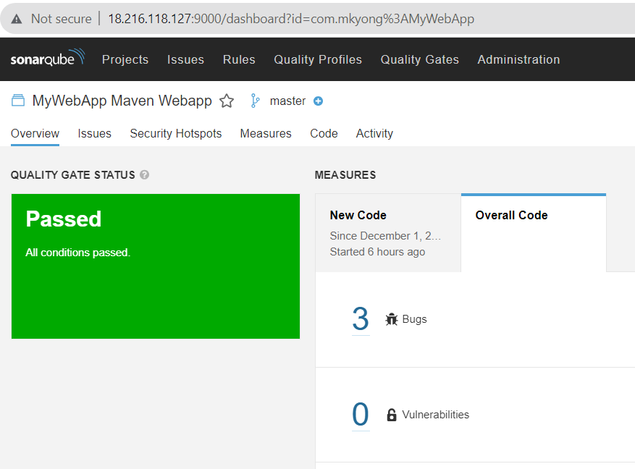
Testing Phase
After a successful build:
Obtain test results
Identify bugs and other relevant data to align with organization integrity.

Slide 12
Conclusion
Through CI/CD pipelines we achieved code quality with out manual intervention.
Enabling a seamless DevOps pipeline not only enhances software quality but also accelerates deployment, fostering a culture of continuous improvement and efficiency in the software development lifecycle.

Slide 13
Thank you ☺

